Slide 1
Queue

Slide 2
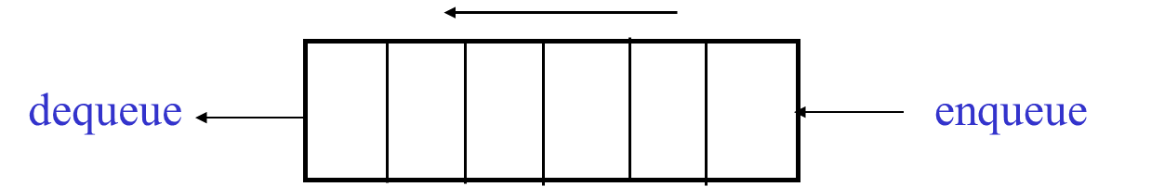
What is a Queue?
Queue is a kind of abstract data type (a linear data structure)
With a queue insertion is done at one end whereas deletion is done at the other end
Queues implement the FIFO (first-in first-out) policy. E.g., a printer/job queue!
Two basic operations of queues:
dequeue: remove an item/element from front
enqueue: add an item/element at the back

Slide 3
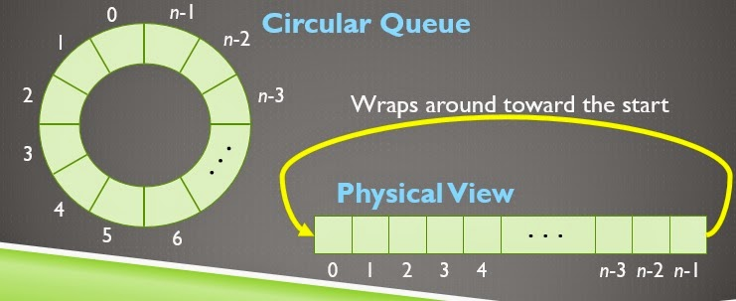
What is a Queue?
Like stacks, queues are lists. With a queue, however, insertion is done at one end whereas deletion is done at

Slide 4
Circular array
[ 0 ]
[1]
[ 2 ]
[ 3 ]
[ 4 ]
[ 5 ]
. . .
4
8
6
An array of integers to implement a queue of integers
We don't care what's in
this part of the array
Notes:
Just like our stack implementation in the previous chapter, one way to implement a queue is to store the elements in an array.

Slide 5
Circular array
The easiest implementation also keeps track of the number of items in the queue and the index of the first element (at the front of the queue), the last element (at the rear)
3
size
0
first
[ 0 ]
[1]
[ 2 ]
[ 3 ]
[ 4 ]
[ 5 ]
. . .
last
2
4
8
6
Notes:
The easiest implementation also keeps track of three numbers. The size could be as small as zero or as large as the number of items in the array. The index of the front element is stored in the first member variable. The front item in the queue is at that index of the array. The next item is after the first one and so on until the rear of the queue that occurs at the index stored in a member variable called last.

Slide 6
Circular array
When an element leaves the queue, size is decremented, and first changes, too
2
size
1
first
2
last
[ 0 ]
[1]
[ 2 ]
[ 3 ]
[ 4 ]
[ 5 ]
. . .
4
8
6
Notes:
This shows how the member variables change when an item leaves the queue.

Slide 7
Circular array
When an element enters the queue, size is incremented, and last changes, too.
3
size
1
first
3
last
[ 0 ]
[1]
[ 2 ]
[ 3 ]
[ 4 ]
[ 5 ]
. . .
8
6
2
Notes:
And this shows how the member variables change when a new item enters the queue. For a fixed size array, a new item may enter only if the current size of the queue is less than the size of the array. For a dynamic array, we could increase the size of the array when the queue grows beyond the current array size.

Slide 8
Circular array
There is special behavior at the end of the array. For example, suppose we want to add a new element to this queue, where the last index is [5]:
3
size
3
first
5
last
[ 0 ]
[1]
[ 2 ]
[ 3 ]
[ 4 ]
[ 5 ]
2
6
1
Notes:
And this shows how the member variables change when a new item enters the queue. For a fixed size array, a new item may enter only if the current size of the queue is less than the size of the array. For a dynamic array, we could increase the size of the array when the queue grows beyond the current array size.

Slide 9
Circular array
The mod operator (%) is used to calculate remainders:
1%5 = 1, 2%5 = 2, 5%5 = 0, 8%5 = 3
mod can be used to calculate the front and back positions in a circular array, therefore avoiding comparisons to the array size
The back of the queue is:
(front + size - 1) % capacity;
where count is the number of items currently in the queue
After removing an item the front of the queue is:
(front + 1) % capacity;

Slide 10
Queue: Linked List
Implementation
A queue can also be implemented with a linked list with both a head and a tail pointer.
Which end do you think is the front of the queue? Why?
13
15
10
7
head_ptr
null
tail_ptr

